Slide 1
Lite – Tech
➢ A Full Stack Mini Project , E-Commerce application
1602-19-733-125
Aditya Mogili
1602-19-733-153
Rajesh Pathi

Slide 2
Introduction
A platform for selling and purchasing of goods, where customer should initially login then only, he has privilege to buy items.
User can navigate through different products available and buy these products,
User can also see his transaction history.
Admin has the privilege to add new items which user can also avail them.
Admin can also see every whole transaction history.

Slide 3
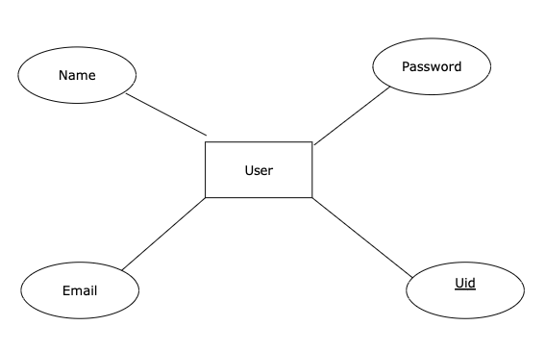
Data Base DESIGN
User Table

Slide 4
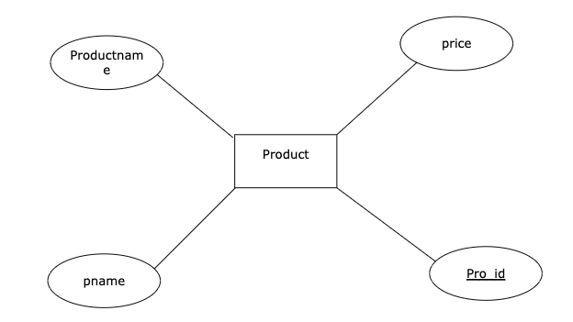
Product Table

Slide 5
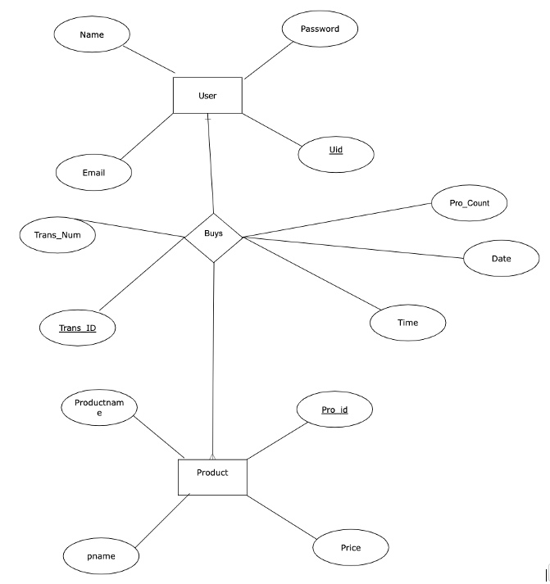
Overall Data Base Schema

Slide 6
User Panel Results

Slide 7
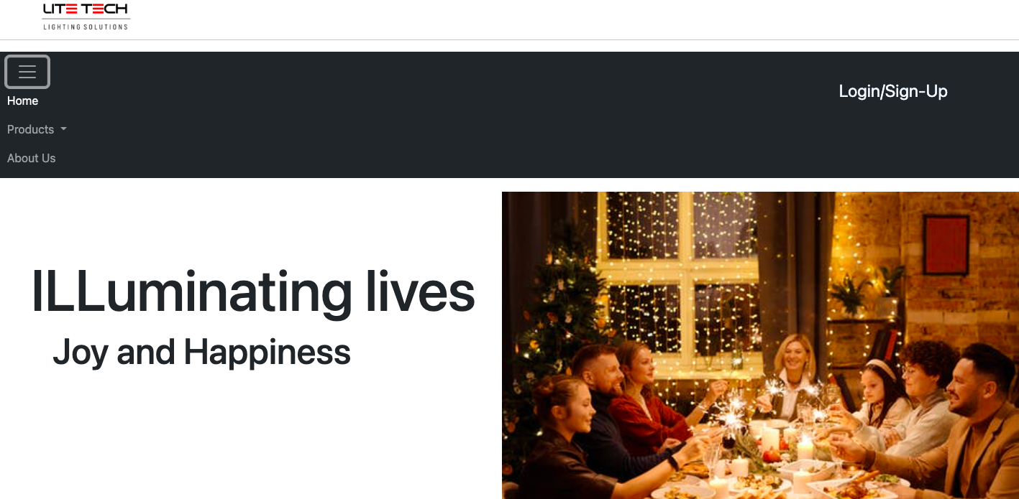

Slide 8
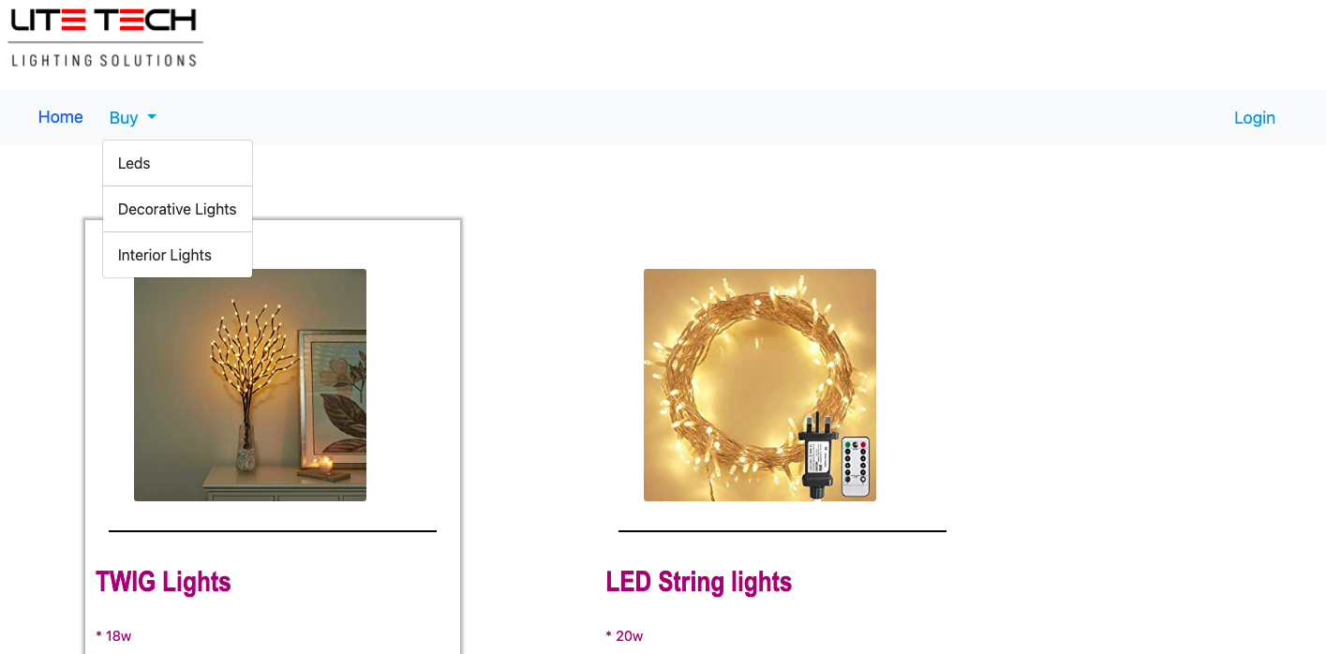
User Can Navigate Through pages
User Needs to Login to buy Items

Slide 9
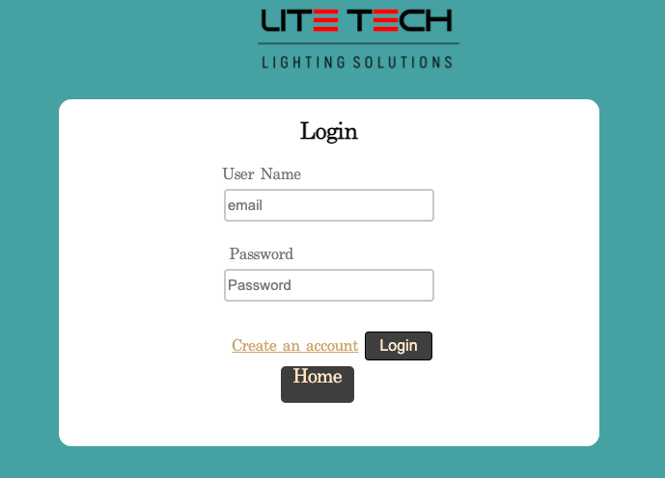
User Details shouldn’t be empty they’ll be validated
Redirected to Sign Up Page

Slide 10
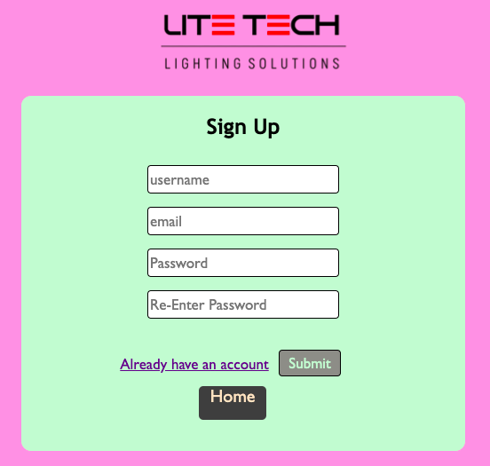
These fields must be filled,

Slide 11
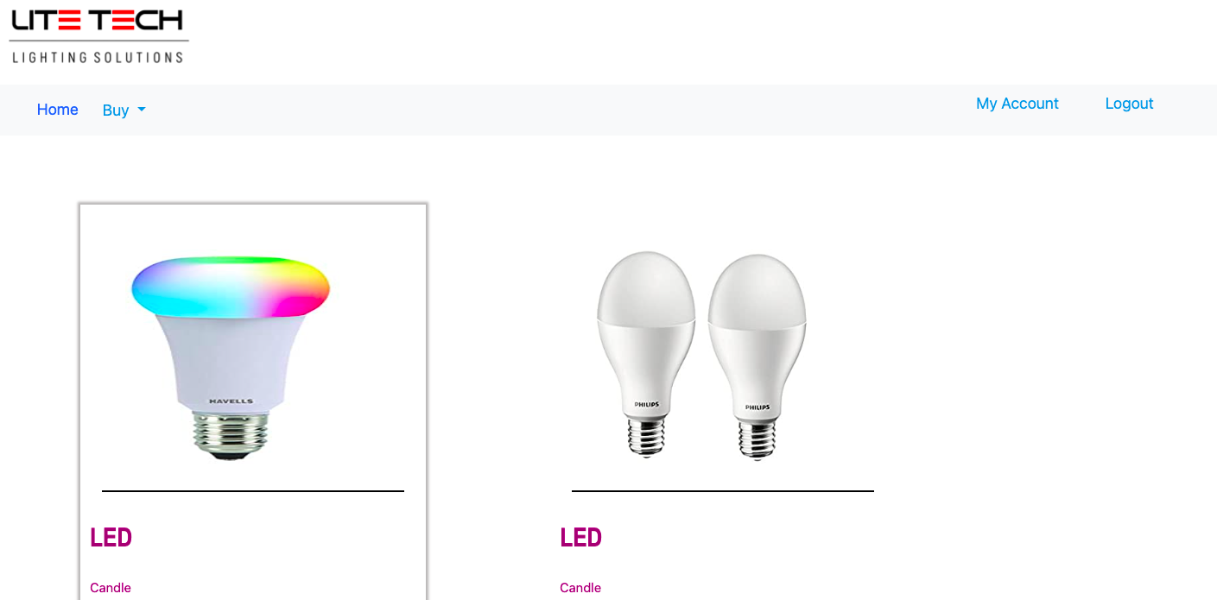
After Logging In User Can
now buy items

Slide 12

Different Products Sold

Slide 13
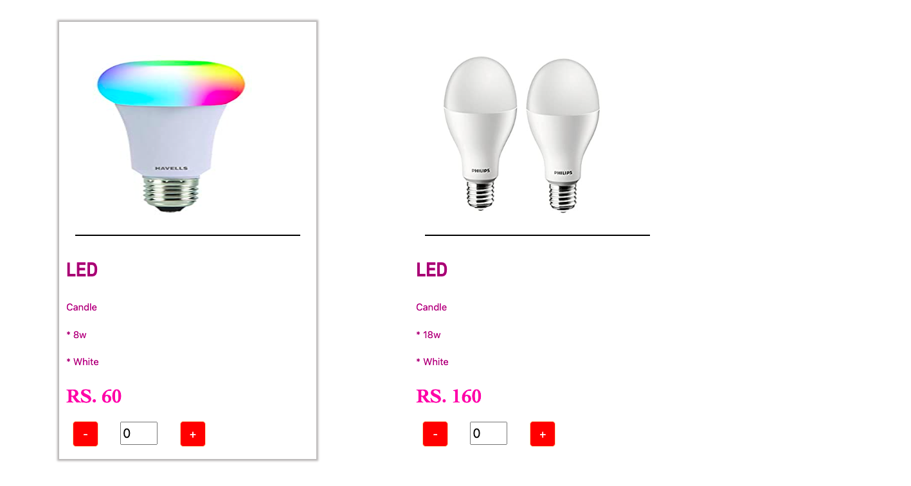
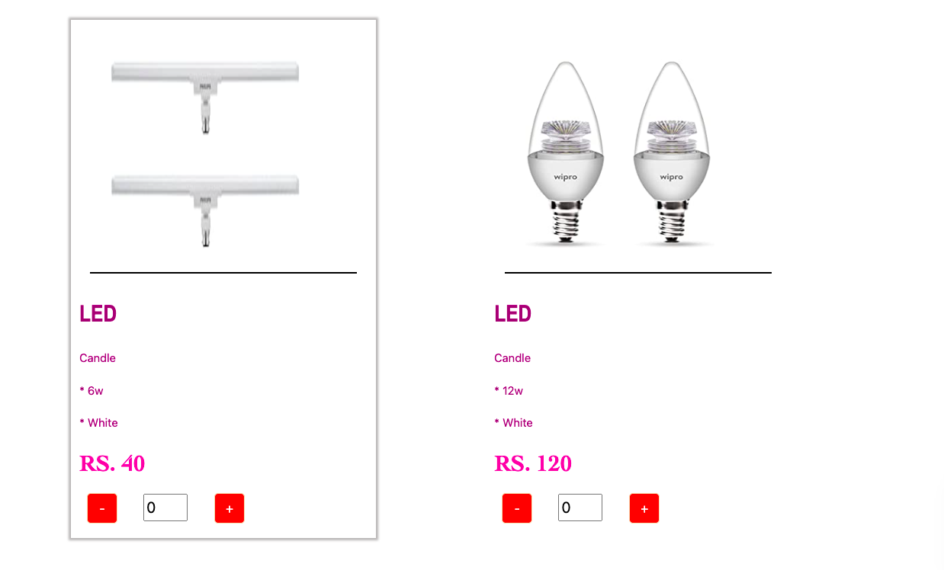

Slide 14
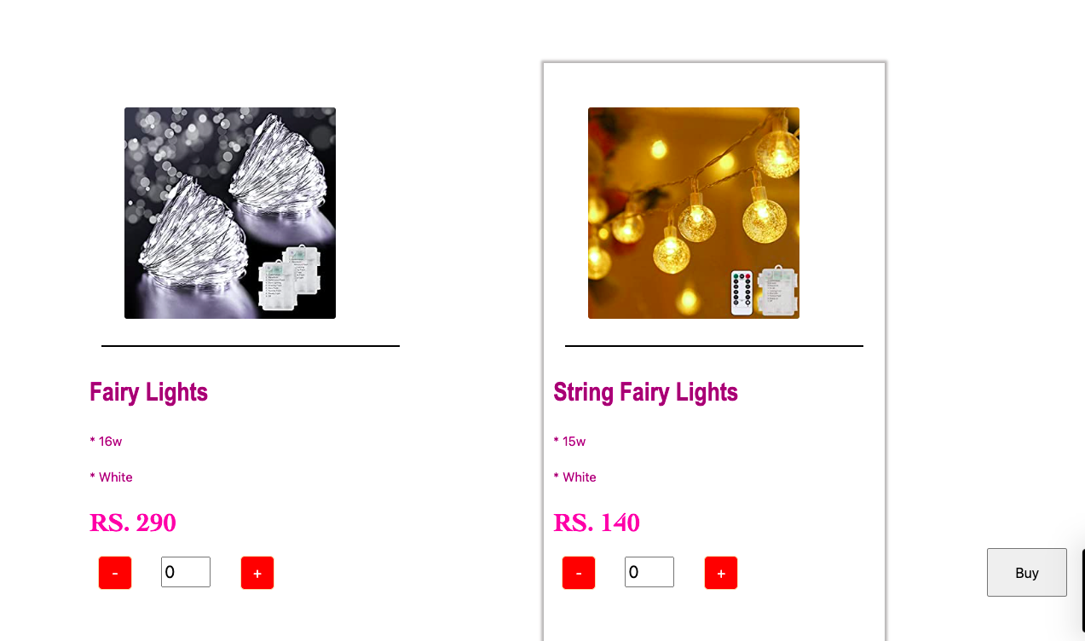
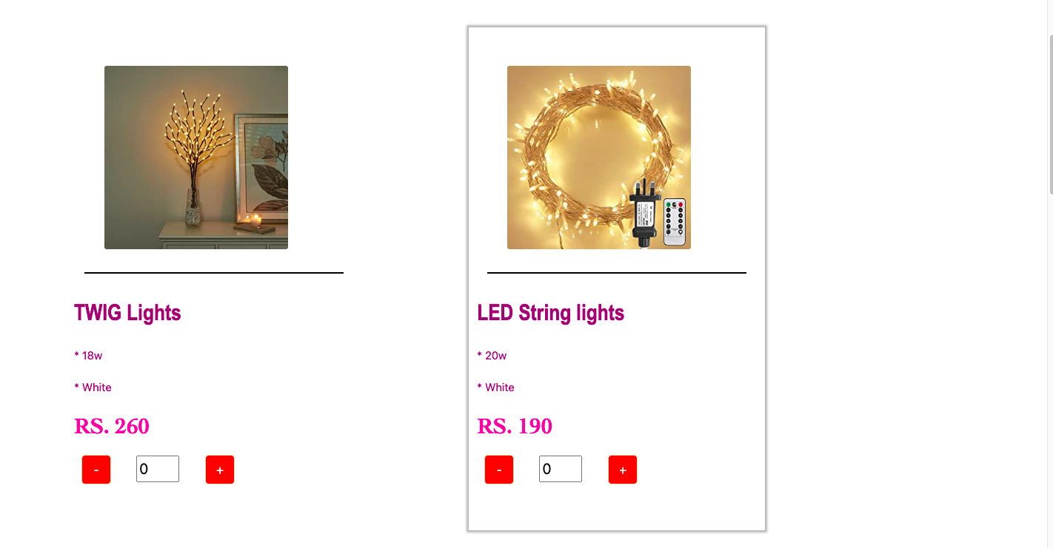

Slide 15

Transaction History of User

Slide 16
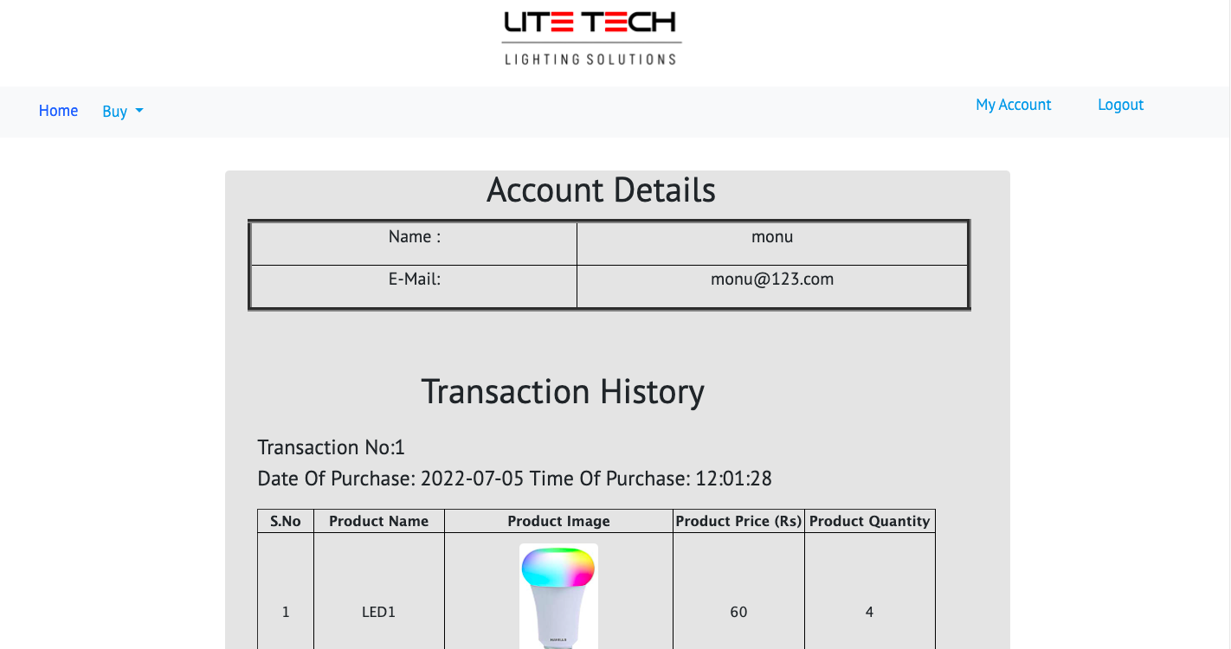

Slide 17
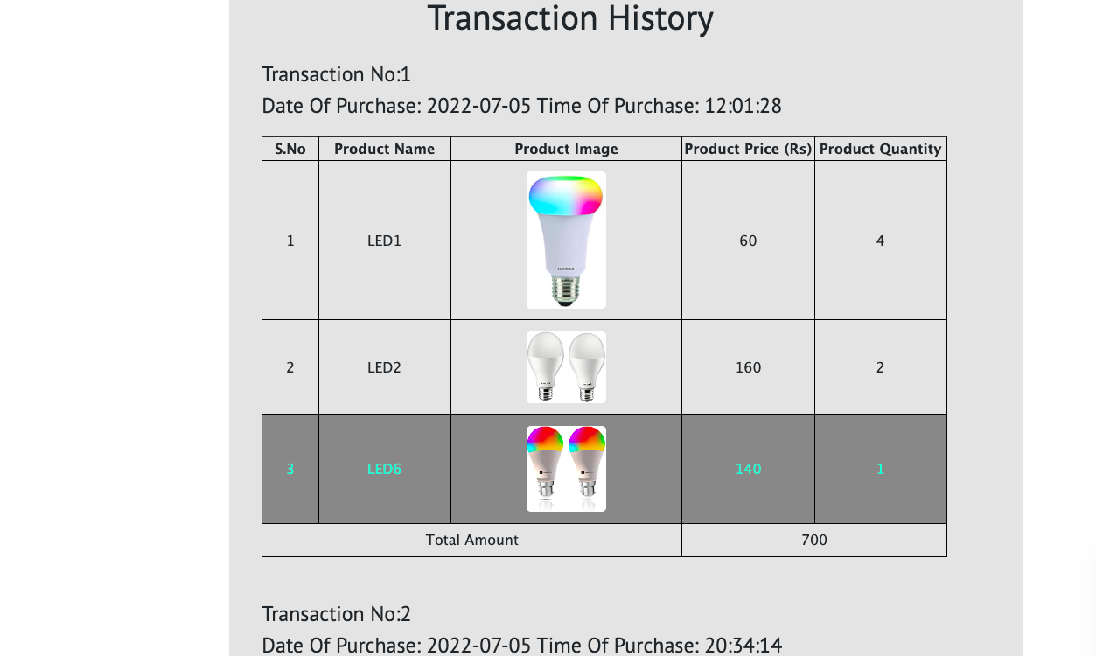

Slide 18
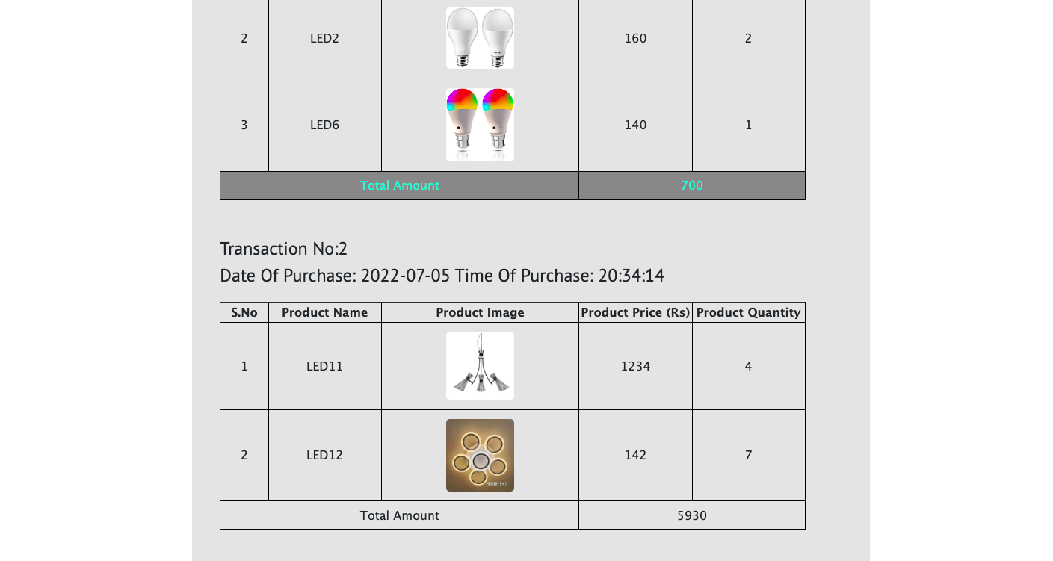

Slide 19
ADMIN PAGE

Slide 20
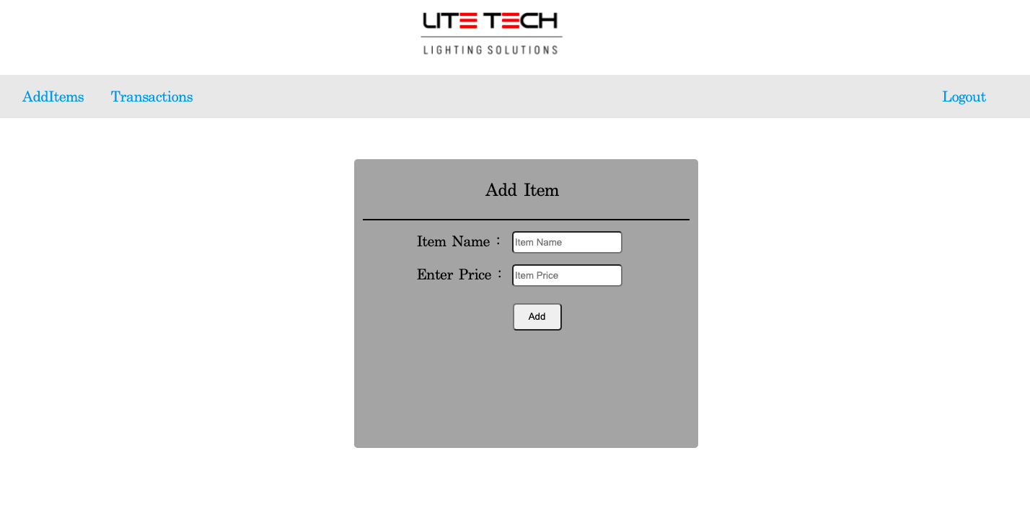

Slide 21

Transactions Page Of Admin

Slide 22
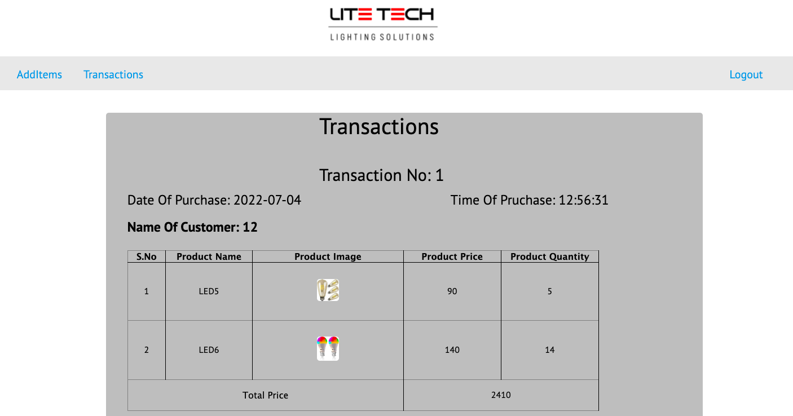

Slide 23
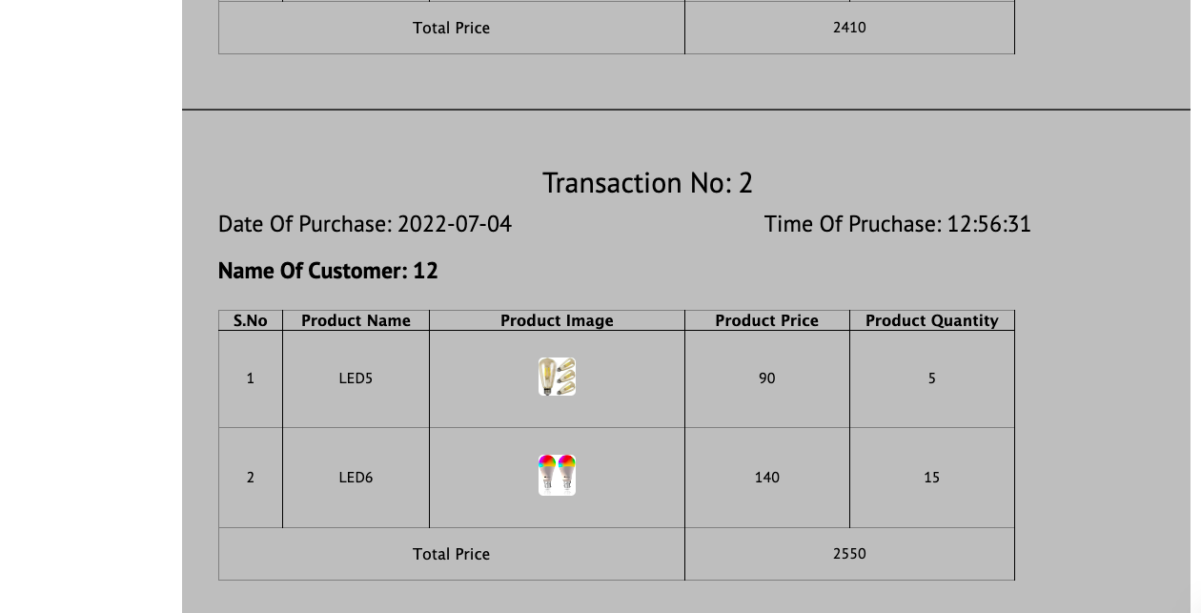

Slide 24
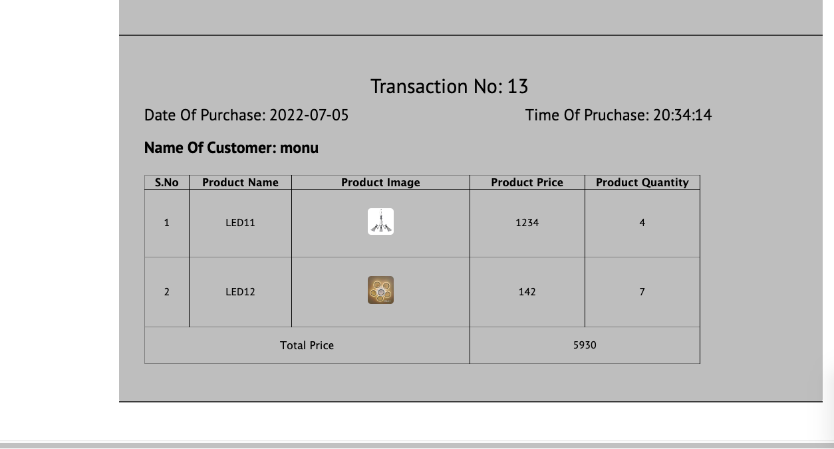

Slide 25
Data Base

Slide 26
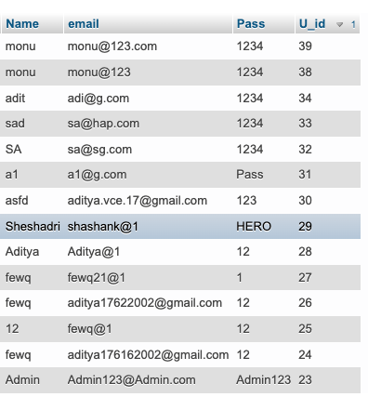
User TAble
The table on left depicts all the user details that are registered.

Slide 27
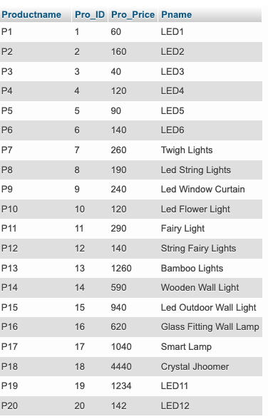
Product Table
The Table on left depicts all the available products/sold products, Admin can also add more products

Slide 28
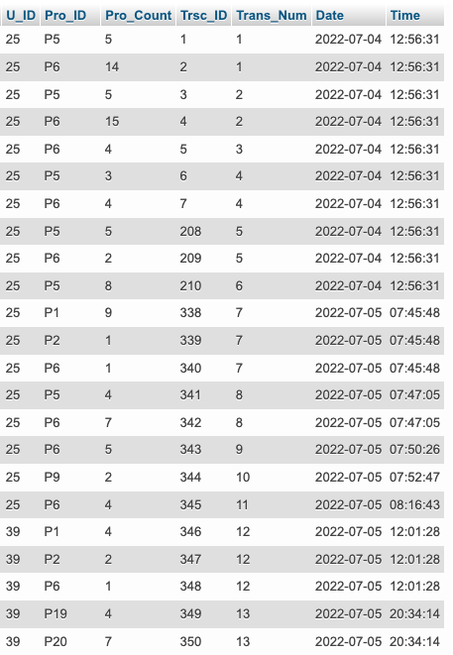
Transaction table
The table on left depicts each of the transaction done by different users

Slide 29
Future Work
We would like to extend this project by adding the following features
Admin Can also delete items
Admin Can edit user details
Forgot Password Feature.

